Slide 1
Restricted mean models
蒋智超
2022年 秋

Slide 2

Restricted mean model
The logistic, Poisson, and Negative-Binomial models are extensions of the normal linear model
We have discussed OLS as a restricted mean model
No additional assumptions (e.g., the variance) on the conditional distribution
What are the analogs for the binary and count models?
For binary outcome, the conditional mean determines the distribution, so the misspecification of
the conditional mean implies the misspecification of the conditional distribution
For other outcomes, the conditional mean cannot determine the conditional distribution

Slide 3

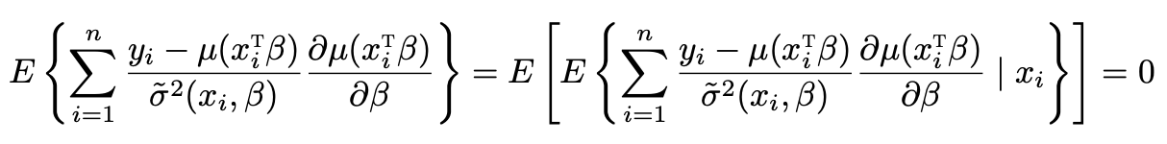
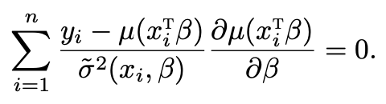
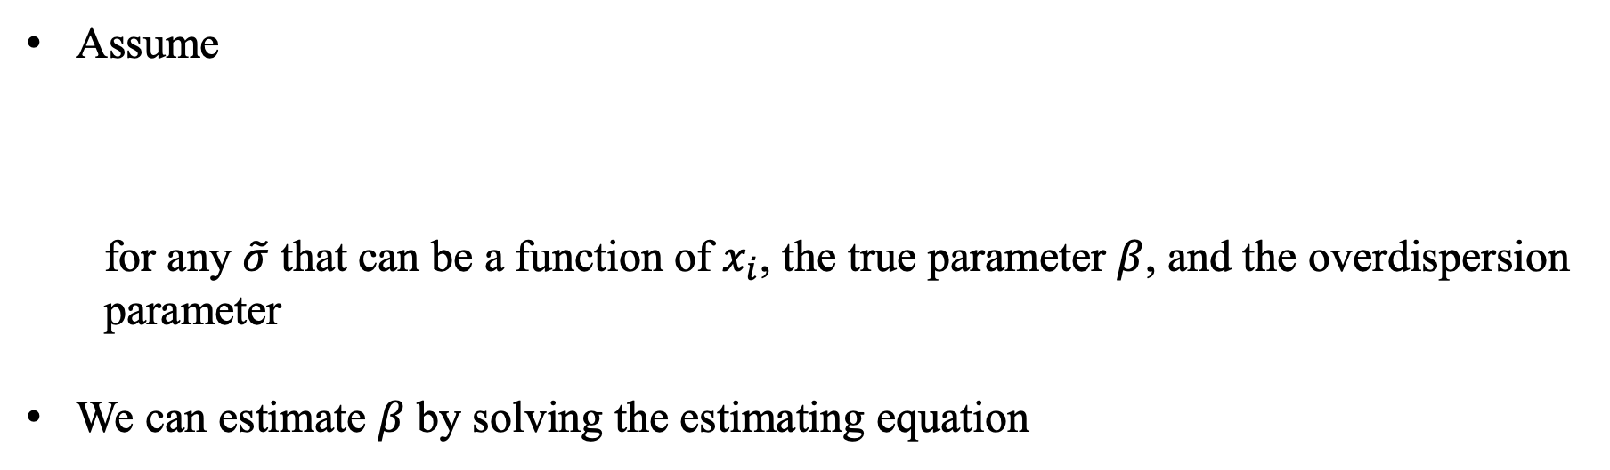
Restricted mean model
Assume
for any $\tilde{σ}$ that can be a function of $x_{i}$, the true parameter $β$, and the overdispersion
parameter
We can estimate $β$ by solving the estimating equation

Slide 4


Restricted mean model
If , then the estimating equation is the score equation
derived from the GLM of an exponential family
If not, then the estimating equation is not a score function but still valid
is a “working” variance
We can interpret MLE from the GLM more broadly
It is valid under a restricted mean model even if the conditional distribution is misspecified
We can construct more general estimators beyond the MLEs from GLMs
We must address the issue of variance estimation since the inference based on the Fisher
information matrix no longer works

Slide 5
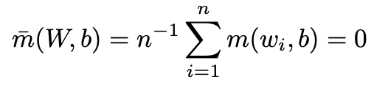
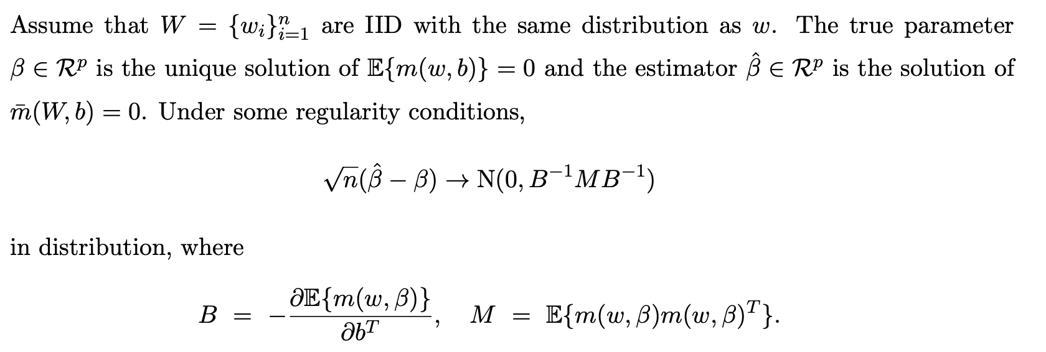
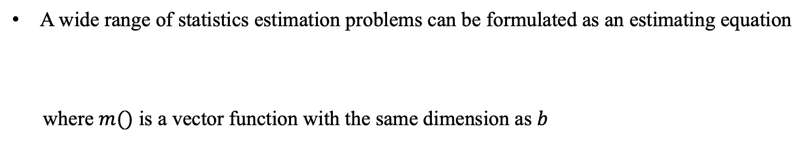
M-estimation
A wide range of statistics estimation problems can be formulated as an estimating equation
where $m()$ is a vector function with the same dimension as $b$

Slide 6
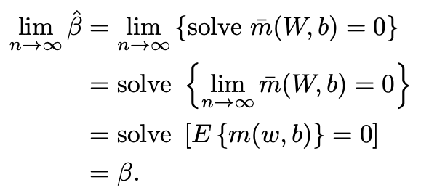

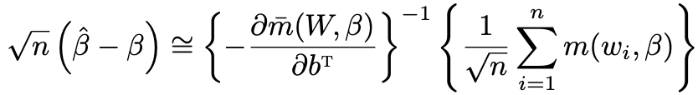
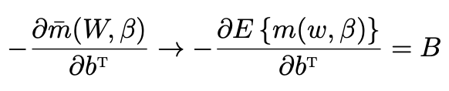
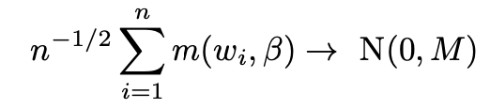
M-estimation
A “physics” proof:
Consistency
Asymptotic Normality

Slide 7

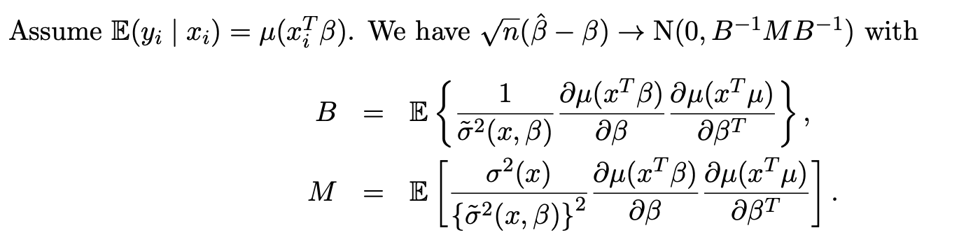
Sandwich covariance matrix
Assume are IID draws (we can also assume fixed covariates)
When the variance is the correctly specified, the asymptotic variance reduces to the
Fisher information matrix

Slide 8
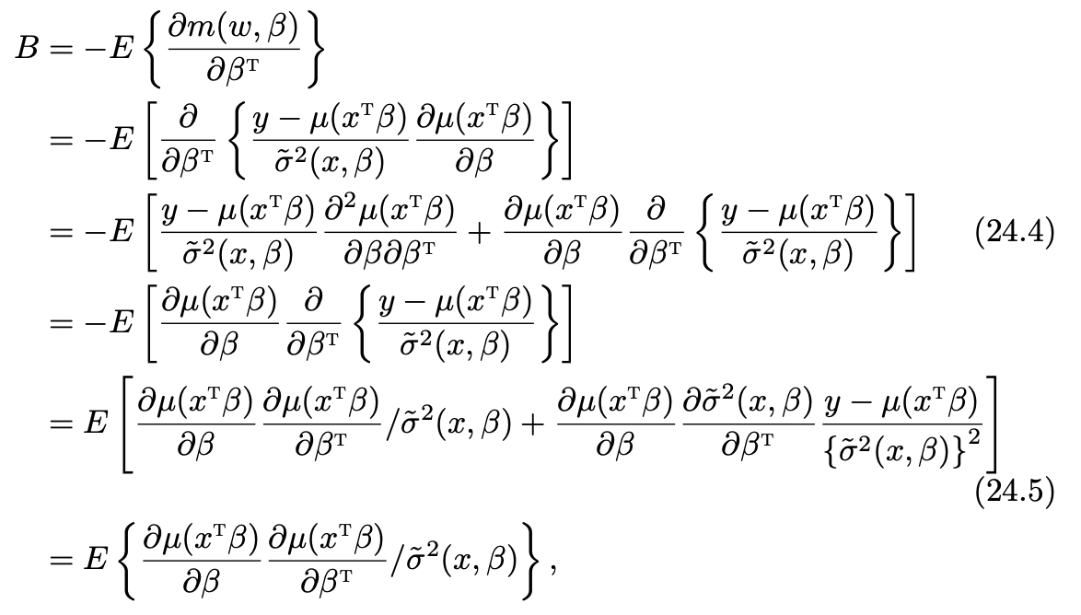
Sandwich covariance matrix

Slide 9
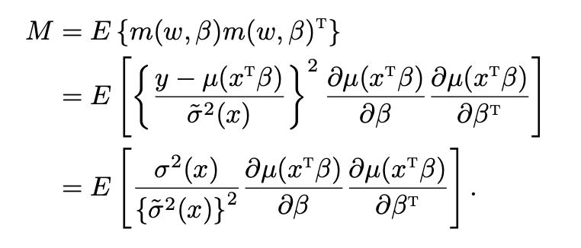
Sandwich covariance matrix

Slide 10


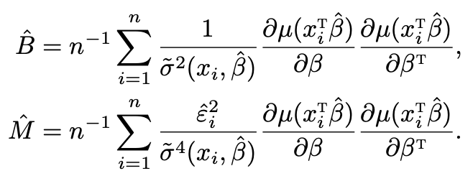


Sandwich covariance matrix
We can estimate the asymptotic variance by replacing $B$ and $M$ by their sample analogs
In R, several functions can compute the EHW standard error
The hccm function and the vcovHC are for OLS
The sandwich function in the sandwich package works for general models
For linear regressions, the sandwich function can compute HC0 and HC1
hccm and vcovHC can compute other HC standard errors

Slide 11
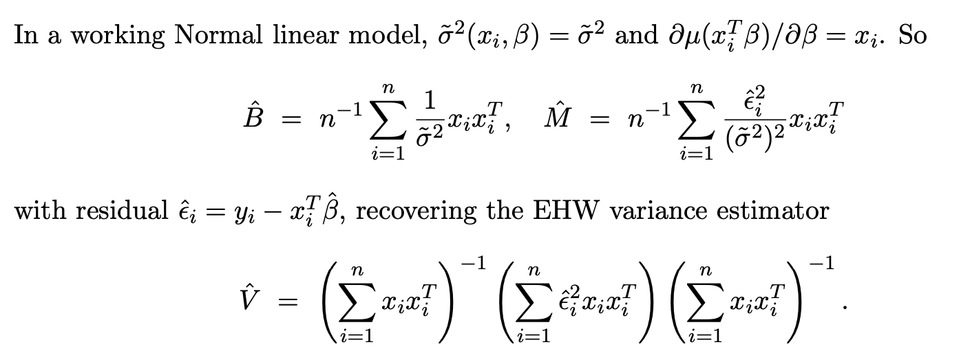
Examples

Slide 12
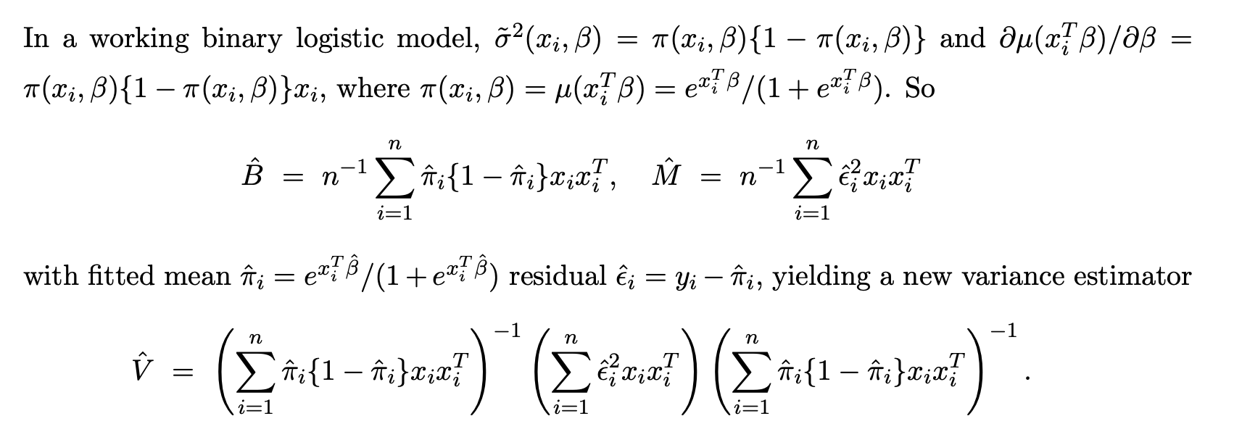
Examples

Slide 13
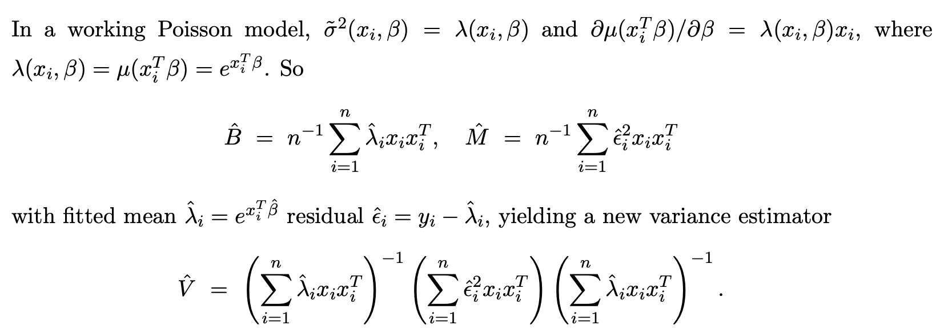
Examples

Slide 14
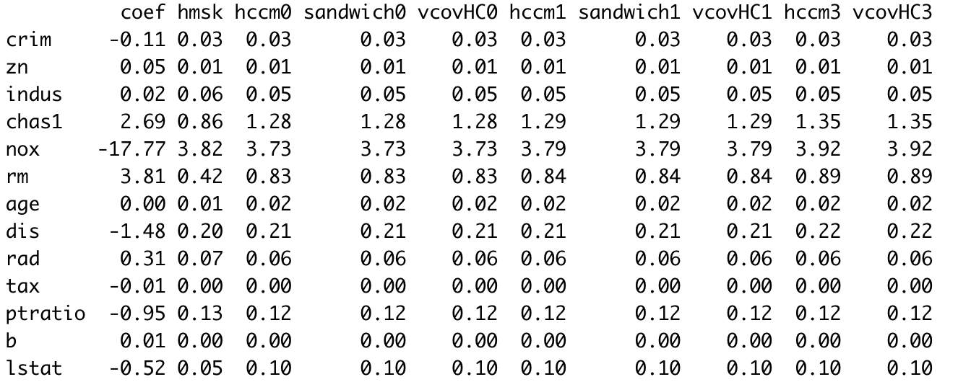
Application: linear regression
Boston housing data

Slide 15
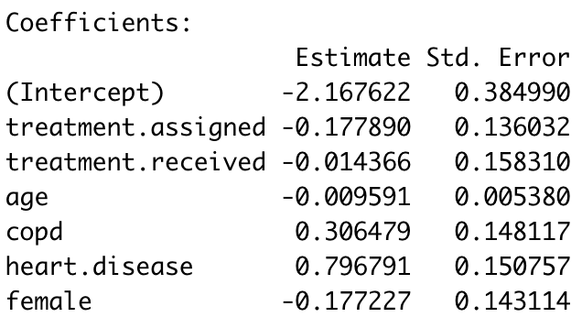
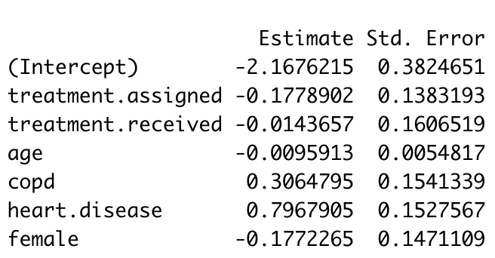
Application: logistic regression
Flu shot data

Slide 16
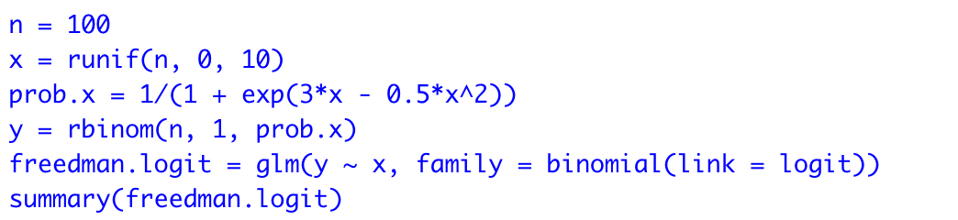
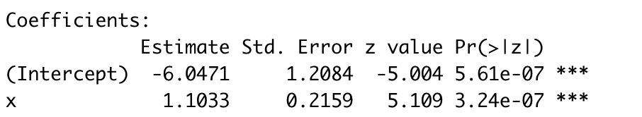
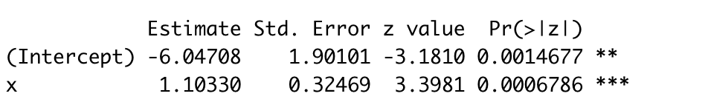
Application: logistic regression
Freedman (2006) discussed the following misspecified logistic regression
Notes:
The discrepancy between the two types of standard errors is a warning of the misspecification of the conditional mean function because it determines the whole conditional distribution

Slide 17
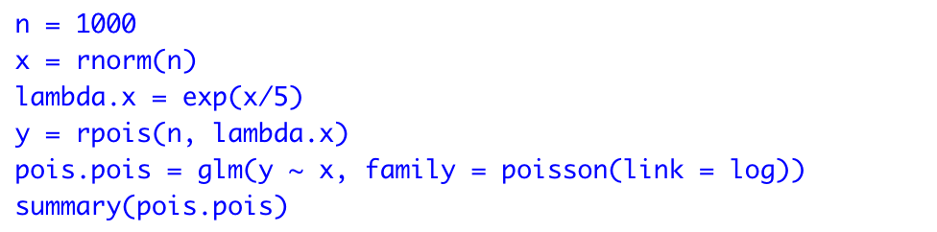
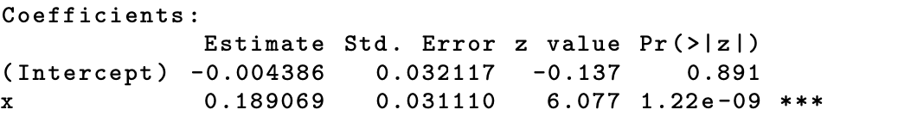
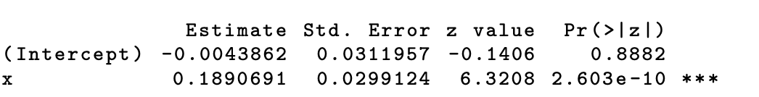
Application: Poisson regression
A correctly specified model

Slide 18
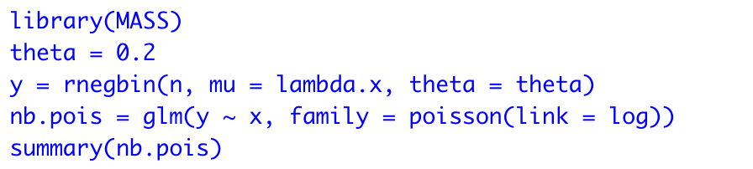
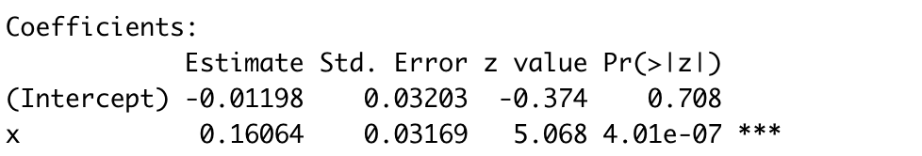
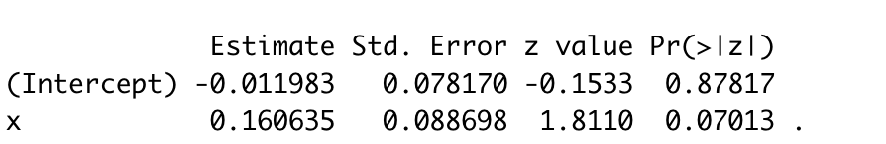
Application: Poisson regression
Data generated from a Negative-Binomial regression model
Notes:
The robust standard error doubles the classical standard error.

Slide 19

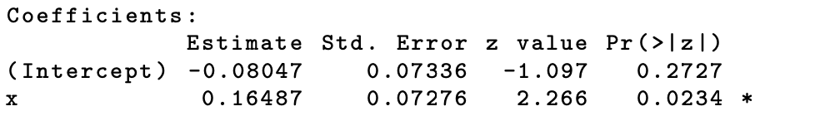
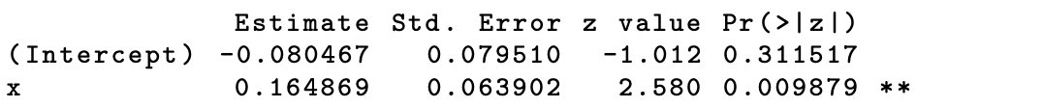
Application: Poisson regression
Data generated from a Negative-Binomial regression model
Use the correct model to fit the data
Overall, if we are only interested in the conditional mean,
Poisson regression suffices as long as we use the robust standard error
Notes:
the robust standard errors from the Poisson and Negative-Binomial regressions are very close

Slide 20
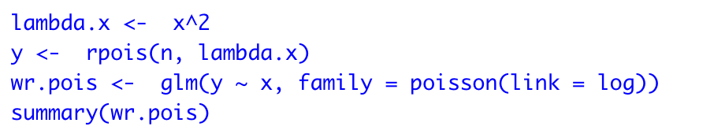
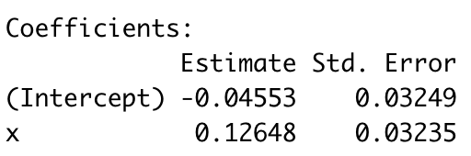
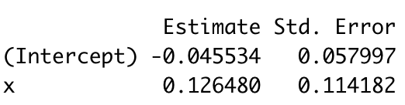
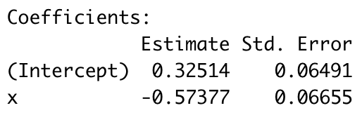
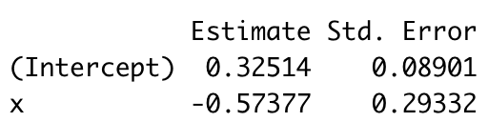
Application: Poisson regression
When the conditional mean function is misspecified
Poisson
NB

Slide 21
Comments
Restricted mean model extends the GLM, allowing for misspecification of the GLM
while preserving the conditional mean
Extension to other parametric models
Huber (1967) started the literature on the statistical properties of the MLE in a
misspecified model
White (1982) addressed detailed inferential problems
Buja et al. (2019) reviewed this topic
The robust sandwich standard errors are unlikely to be helpful if the conditional mean
is misspecified

